Slide 1


Principled Pragmatism and the ‘Inclusion Project’
Implementing a Gender Perspective in Peace Agreements

Slide 2
Defining a Peace Agreement
PA-X “Peace Agreement: formal, publicly-available document, produced after discussion with conflict protagonists and mutually agreed to by some or all of them, addressing conflict with a view to ending it”
UCDP “a peace agreement refers to an agreement between two or more primary warring parties in a conflict, which addresses the disputed incompatibility, either by settling all or part of it, or by clearly outlining a process for how the warring parties plan to regulate the incompatibility.”

Slide 3

What is a Gender Perspective?
UNSCR1325 uses the term but does not define it.
International Criminal Court:
  “Gender perspective’ requires an understanding of differences in status, power, roles, and needs between males and females, and the impact of gender on people’s opportunities and interactions. This will enable the Office to gain a better understanding of the crimes, as well as the experiences of individuals and communities in a particular society”
  –Policy Paper on Sexual and Gender-based Crimes (2014)

Slide 4
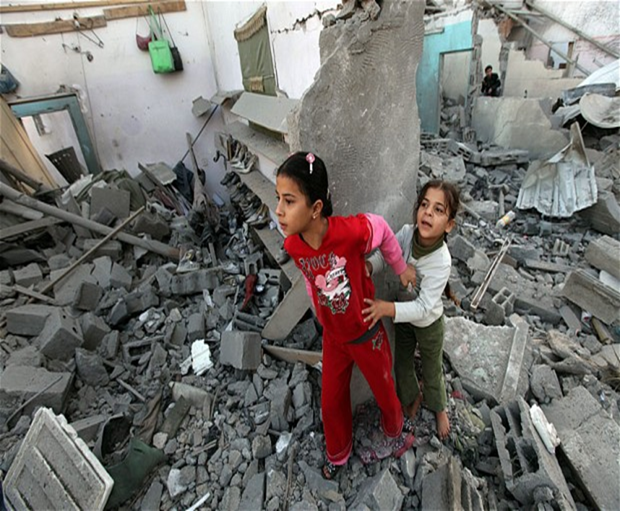
What is a Gender Perspective in Agreements?
Women’s input in peace processes and agreements
Material gains for women
How agreements structured by gender
Power imbalance between men and women

Slide 5
The PA-X Dataset
1,518 peace agreements
1990-2015
Coded on over 200 variables
Permits statistical analysis, but also searches of the full text
Allows questions to be answered about when women are included in agreements, how they are discussed, and gives insight into implementation.

Slide 6
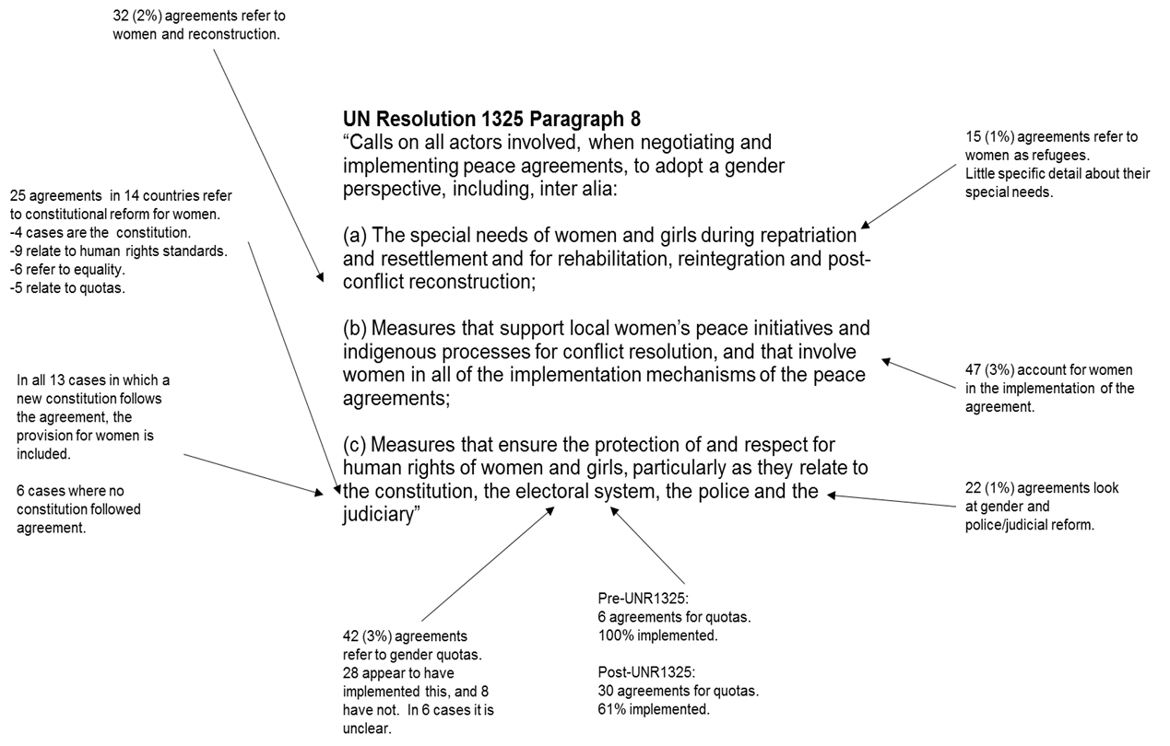
Evaluating Gender Perspectives

Slide 7

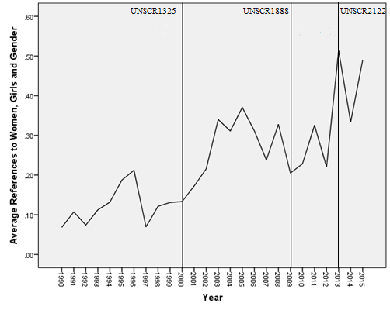

Slide 8
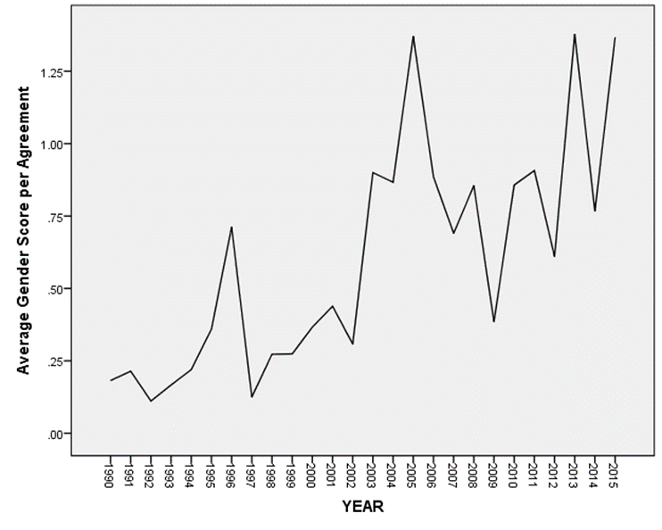
When Women are included: ‘Gender Score’
Women’s participation
Women’s equality
Particular groups of women
International law on gender
New institutions for women
Violence against women
Transitional justice with regard for women
Institutional reform accounting for women
Development
Women’s involvement in implementation
Other references to women

Slide 9
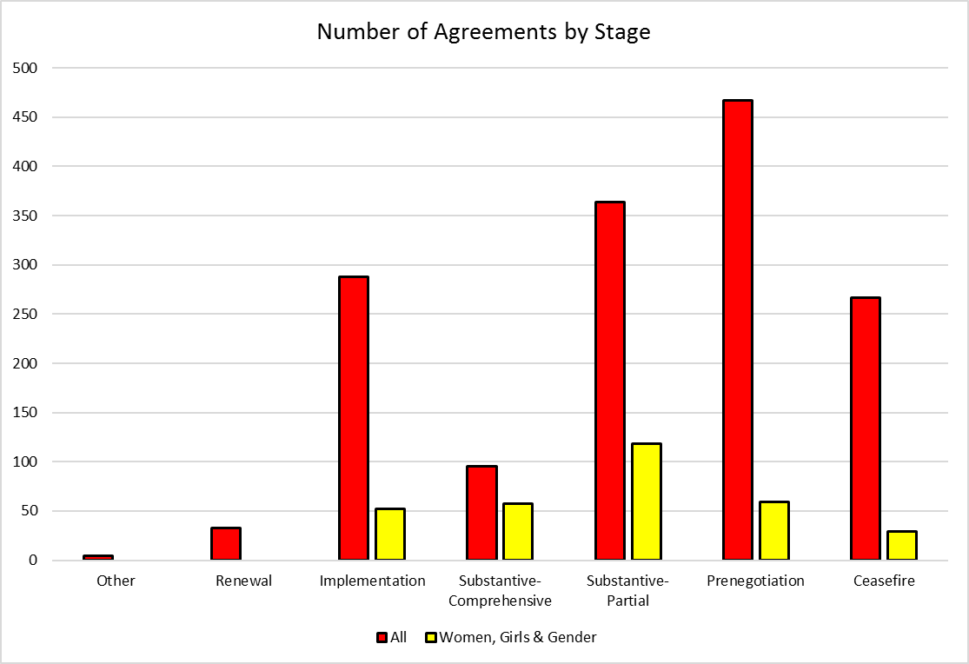

Slide 10
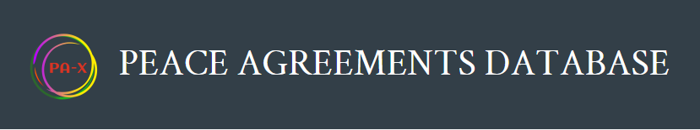
Permits relationships between inclusion and power sharing to be measured
Shows agreements with political power sharing more likely to also discuss women
Permits relationships between inclusion and power sharing to be measured
Shows agreements with political power sharing more likely to also discuss women

Slide 11
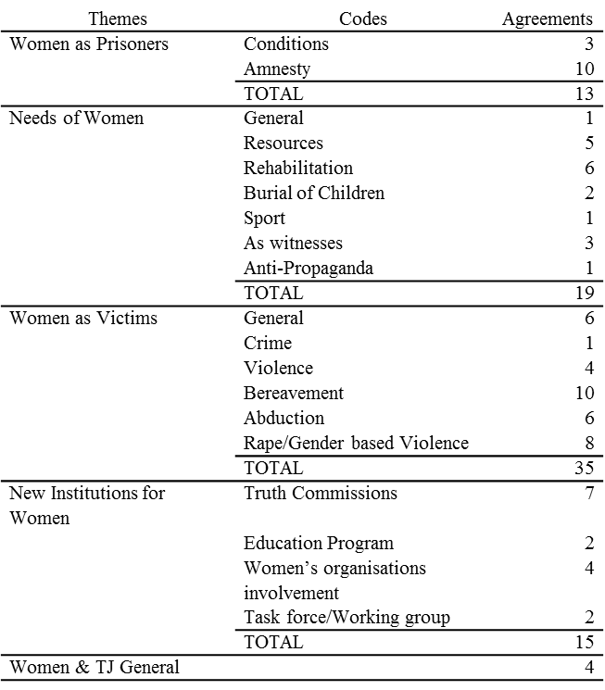
Qualitative Analysis
Thematic analysis (Braun & Clarke, 2006)
49 Agreements discussing Women & TJ
Reveals 4 Themes
  Women as Prisoners
  Needs of Women
  Women as Victims
  New Institutions for Women

Slide 12
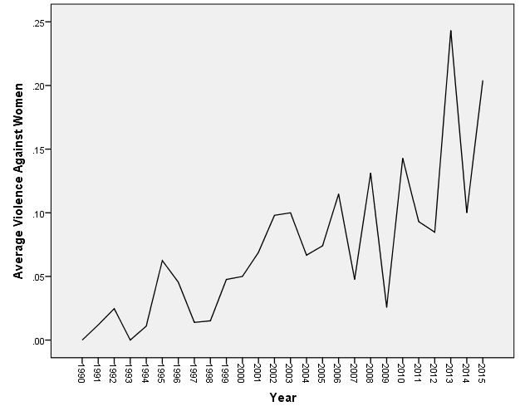
Ways Women are Discussed: Violence against Women

Slide 13
Implementation: Constitutional Changes

Slide 14

Comparing with GQD and other sources for non-legislative quotas
Shows relationships between various factors and implementation rate.

Slide 15
Conclusion
Overall poor rate of inclusion
Inclusion of women greater in comprehensive stages…
…and surprisingly in power sharing agreements
PA-X is a useful, multipurpose tool for agreement analysis.

